Slide 1

CAPSTONE PROJECT GROUP:3
Project Title:ShopForHome
PRESENTED BY:
Prem GM
Amereddy Manjula
Ramya Narra
Chitta Lavanya
Komatireddy Deepika
This Photo by Unknown Author is licensed under CC BY-SA

Slide 2

PROBLEM STATEMENT
ShopForHome is a popular store in the market for shopping the home decor stuff.Due to Covid 19 all the offline shopping stopped.So the store wants to move to the cloud platforms and wants their own web applications.

Slide 3
PROJECT OBJECTIVE
The Objective of this project to make an application in android platform to purchase items in an existing shop.
The application allows the customer to shop virtually using the Internet and allow customers to buy the items and the articles of their desire from the store.

Slide 4
TECHNOLOGIES USED
Front End :Angular, Visual studio code
Back End :Java(Spring boot),Eclipse
Database :PostgreSql
Server :Tomcat9,Google cloud storage

Slide 5
APPLICATION FLOW:
HOME
Admin
User
Sign-up
Sign-up
Sign-in
Sign-in
View Products
Add Products
View Products
Update Products
Delete Products
Add to
Cart/Wishlist
View User
Update User
Delete User

Slide 6
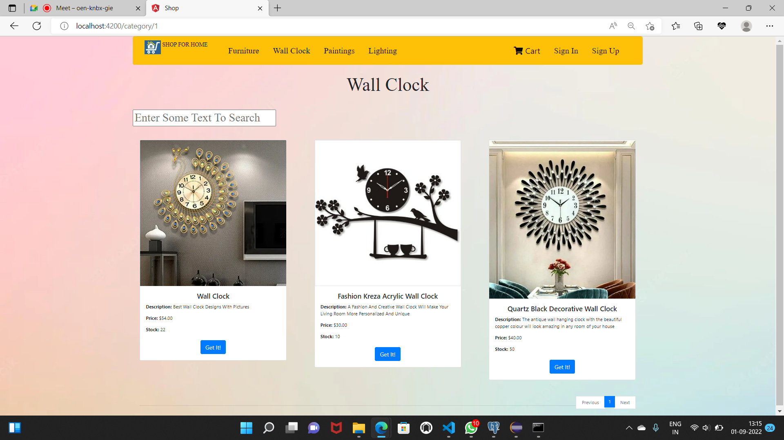
HOME PAGE

Slide 7
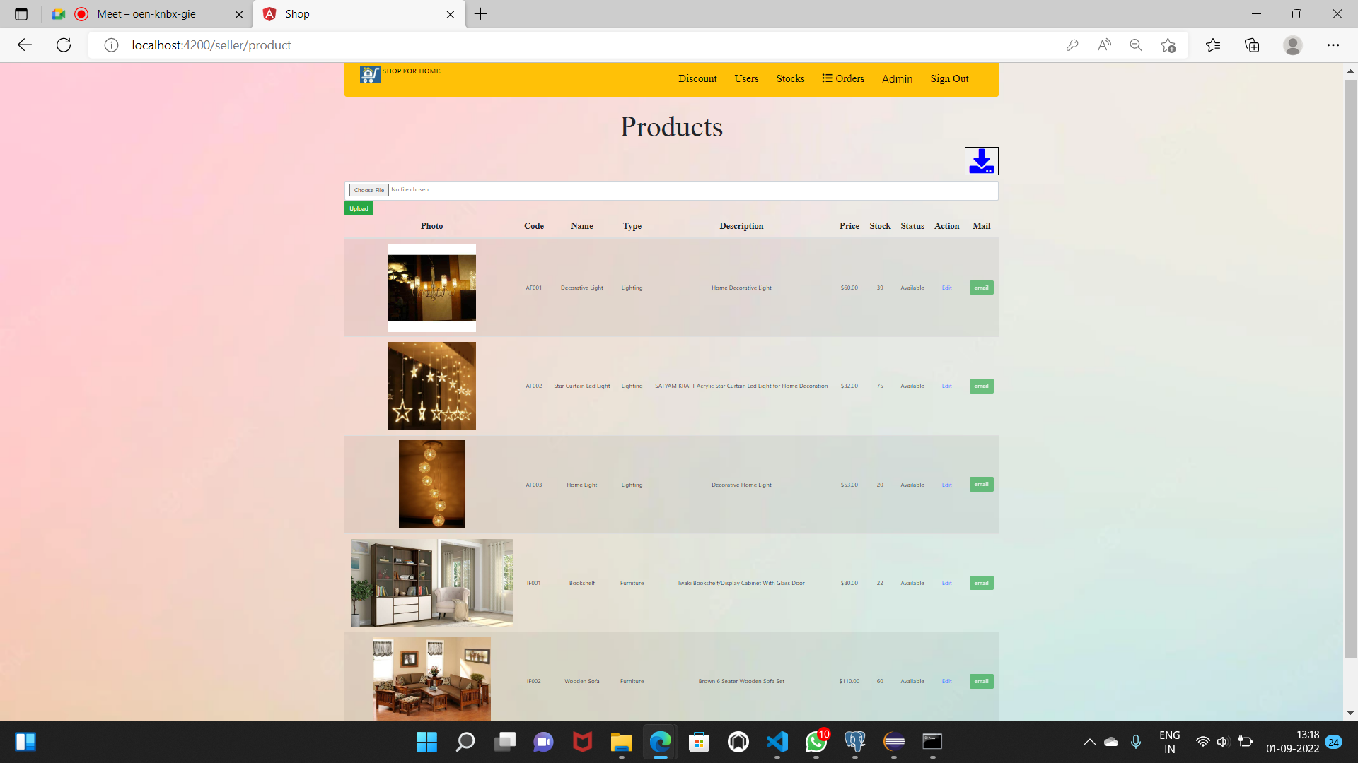
PRODUCTS

Slide 8
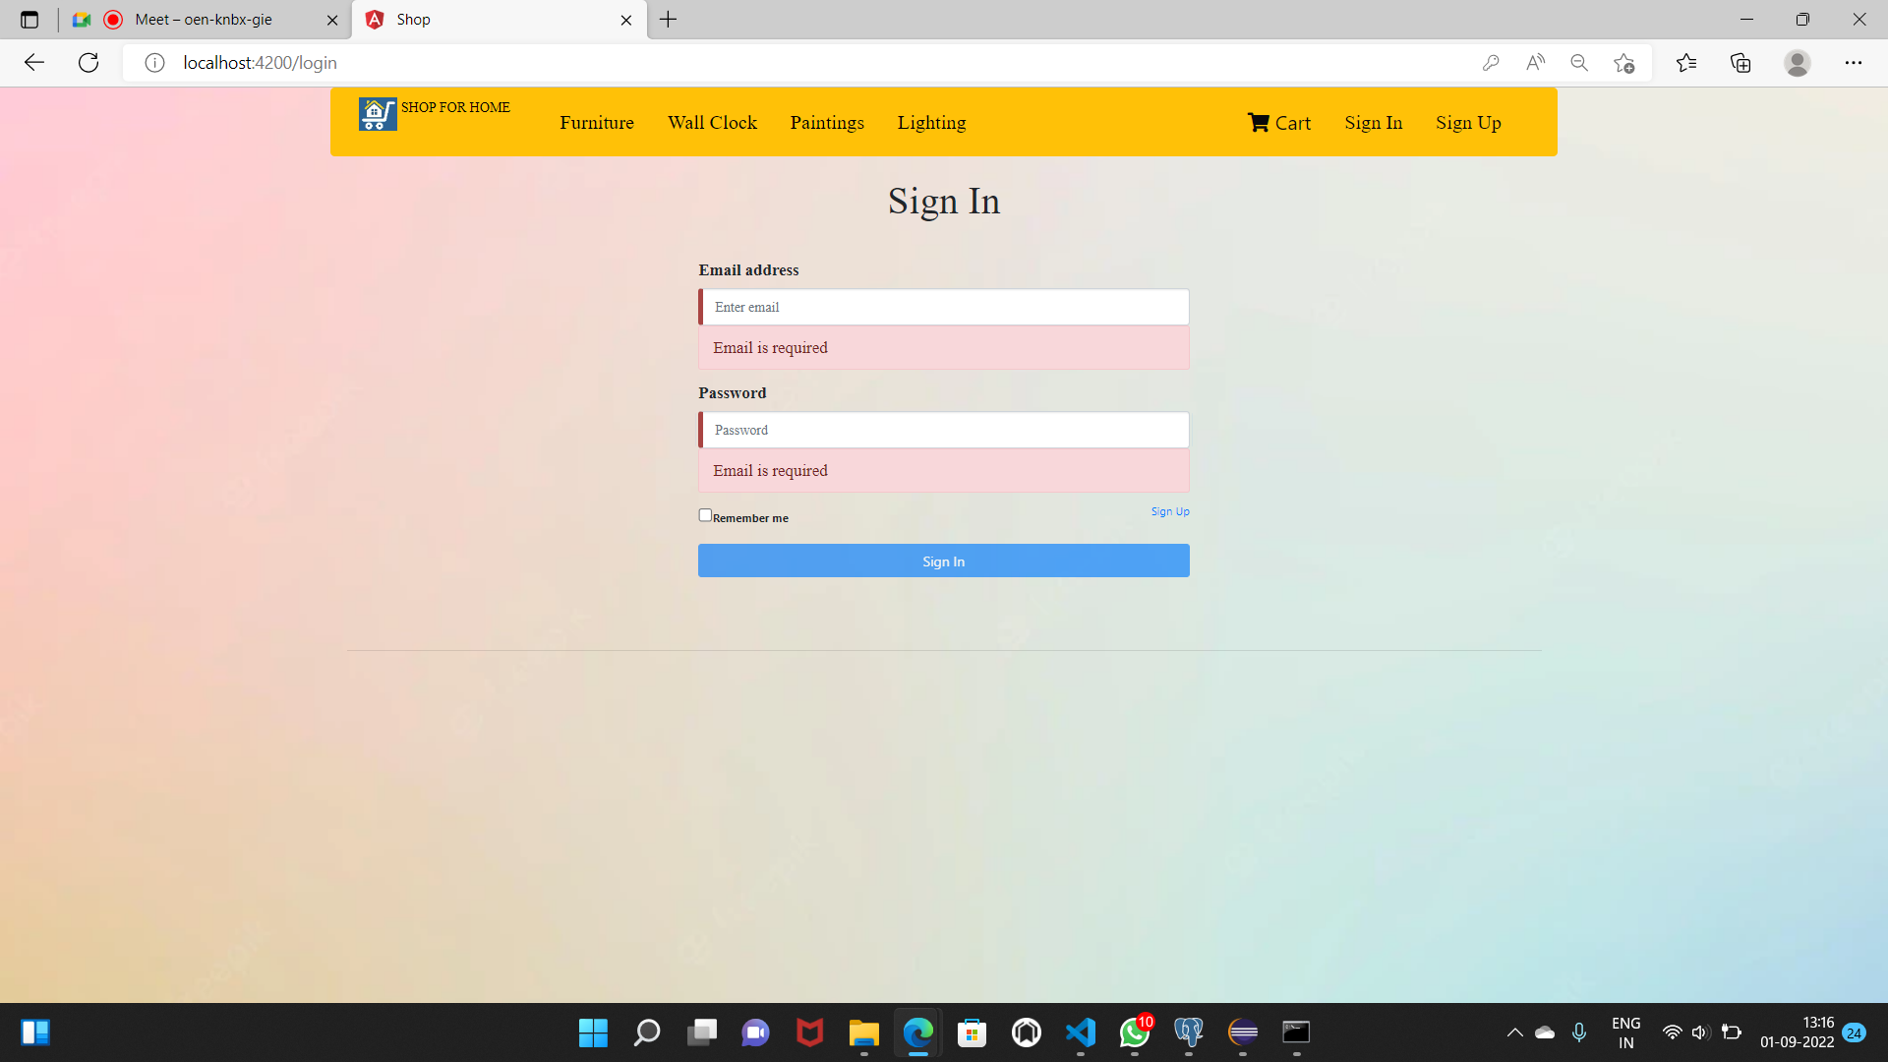
SIGN IN PAGE

Slide 9
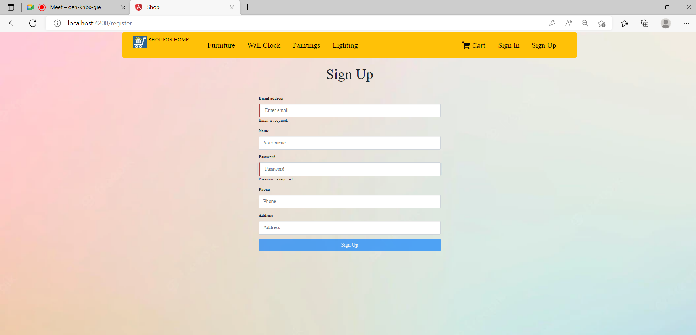
SIGN UP PAGE

Slide 10
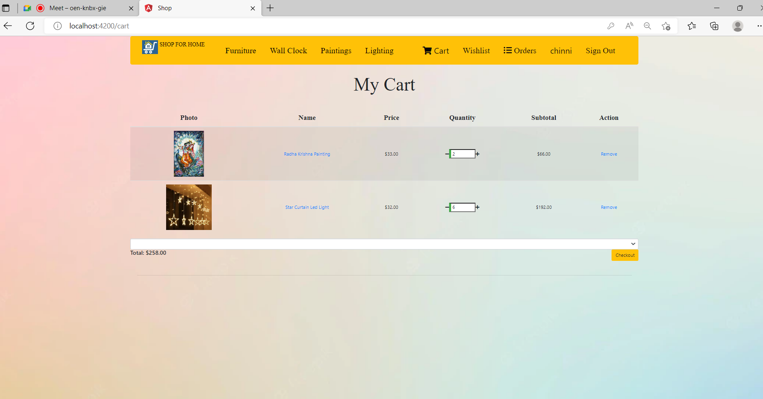
CUSTOMERS CART

Slide 11
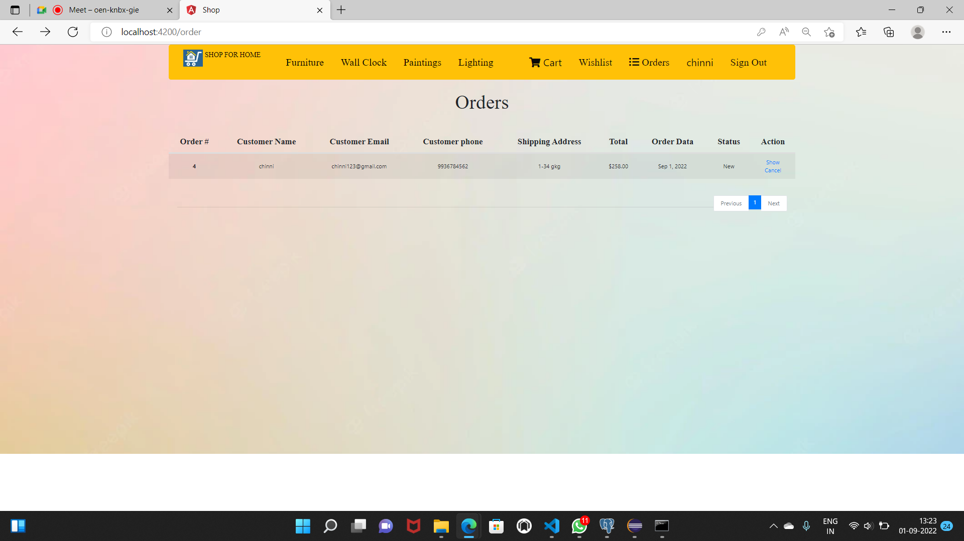
ORDERS

Slide 12
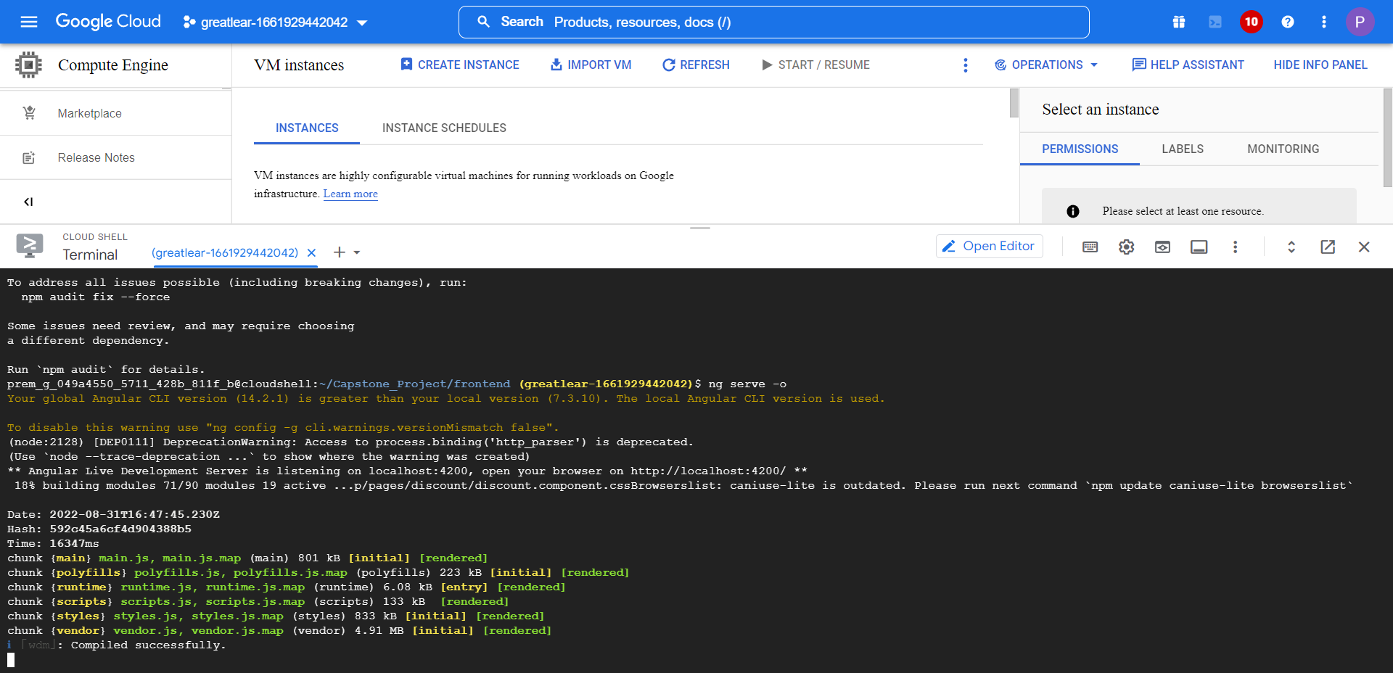
Frontend compiled successfully in GCP

Slide 13
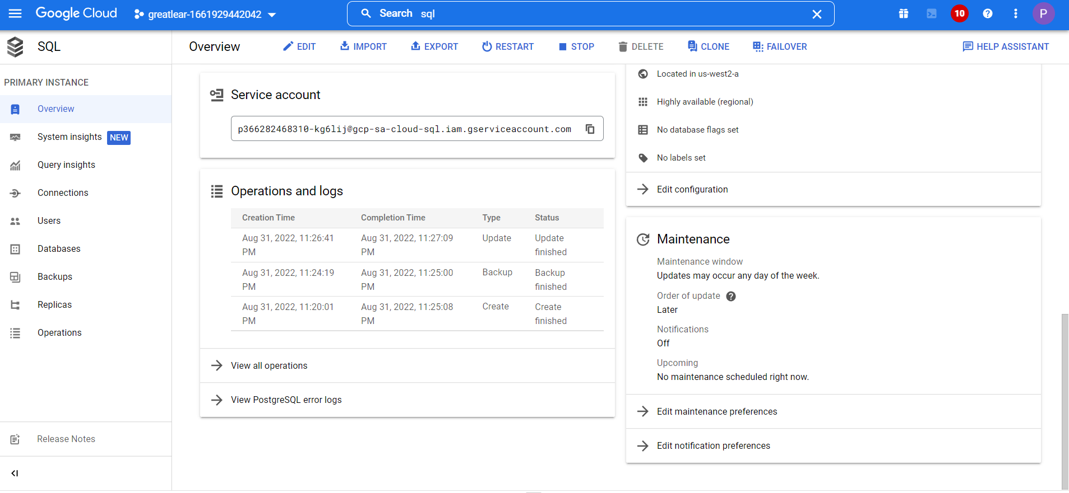
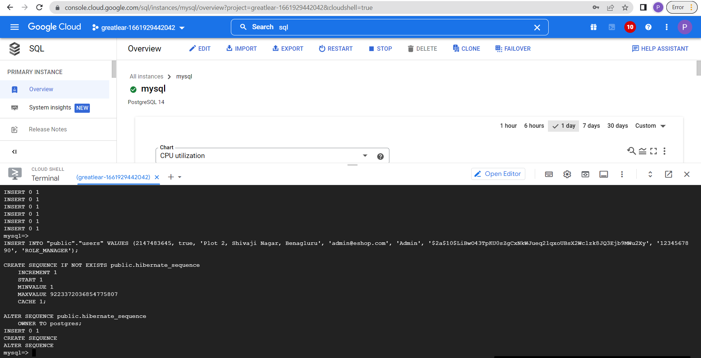
Created postgreSql in GCP

Slide 14
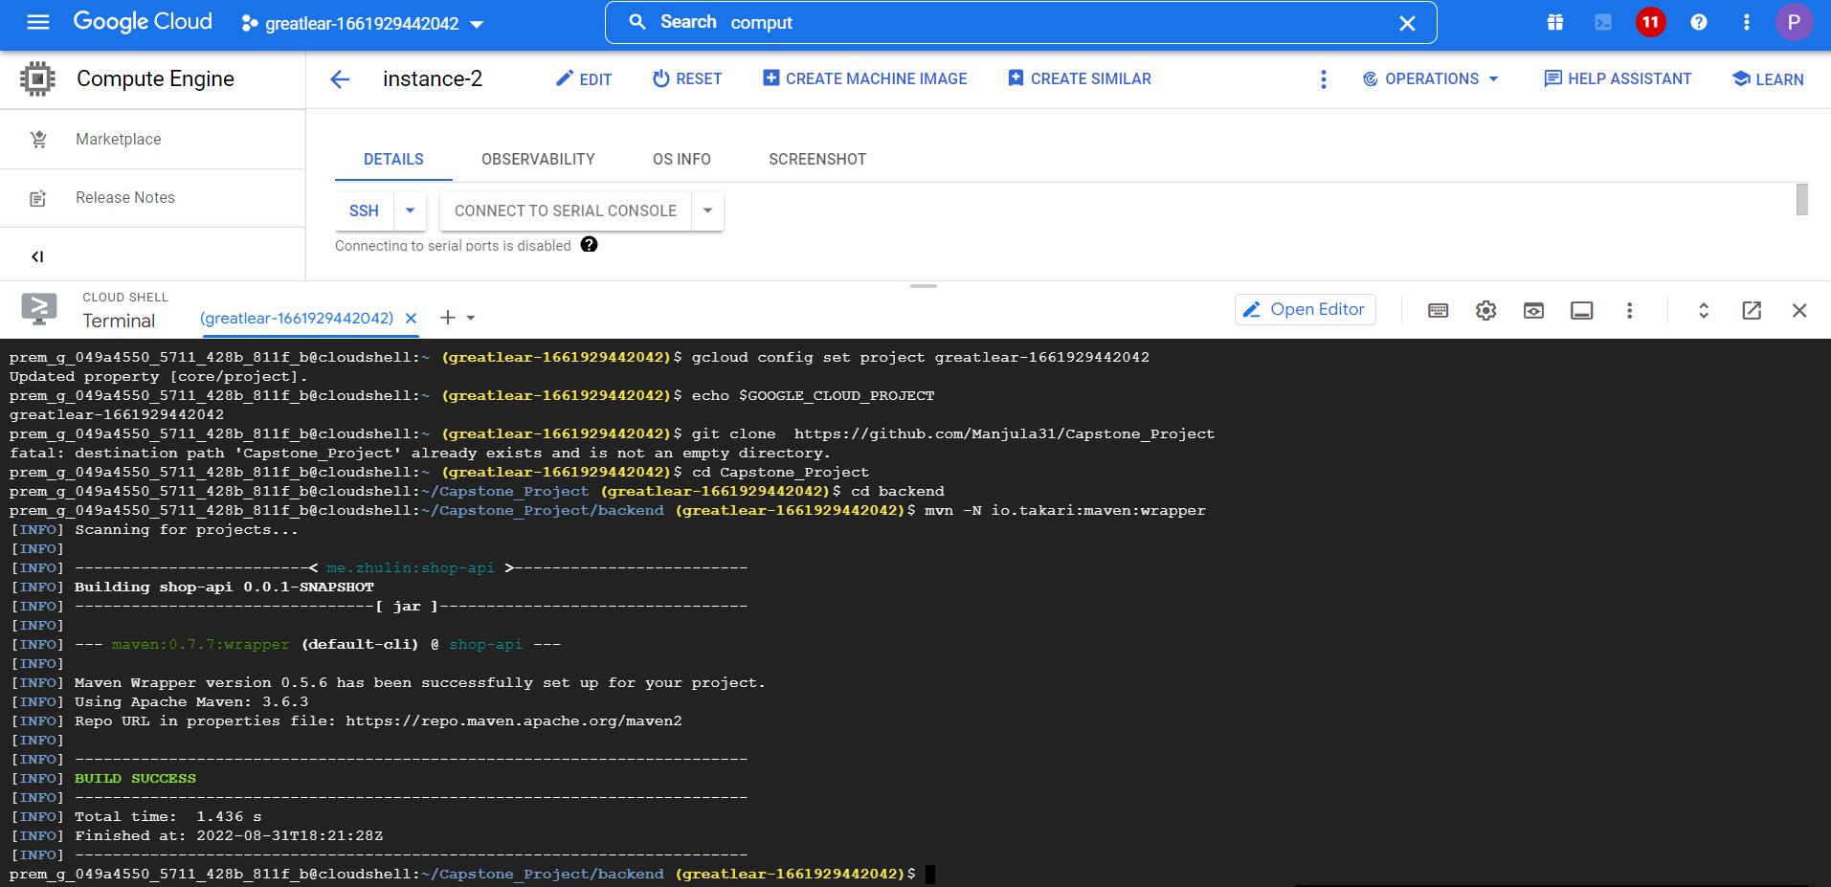
Backend compiled successfully in GCP

Slide 15
CONCLUSION
This E-Commerce Website helps customers to buy products through online without any physical interaction with the sellers due to covid-19.
This project helped us in gaining valuable information and practical knowledge on several topics like designing web pages using html & CSS, usage of responsive templates, designing of android applications, and management of database using MySQL.
The purpose of this project was to develop a web application and an android application for purchasing items from a shop.

Slide 16


